Slide 1
COMP 918: Research Administration for Scientists
First Class - Welcome!
  Tim Quigg, Lecturer and Associate Chair for Administration, Finance and Entrepreneurship Computer Science Department, UNC-Chapel Hill
© Copyright 2013 Timothy L. Quigg All Rights Reserved

Slide 2
Tim’s Background
Past 21 Years: Lecturer and Associate Chair for Administration, Finance and Entrepreneurship, Computer Science Department, University of North Carolina at Chapel Hill – 11th time teaching this course!

Slide 3
Not a Traditional Academic
Past 21 Years: Lecturer and Associate Chair for Administration, Finance and Entrepreneurship, Computer Science Department, University of North Carolina at Chapel Hill – 11th time teaching this course!
Previous 22 Years: Co-founder of two computer software companies; worked for Motorola Computer Systems; CFO for a large NC Human Services state agency; PI of DHEW funded population characteristics study; early grant writer; first white male teacher at NC’s African-American, female state reform school - my 1st job after undergraduate school at Wake Forest University!

Slide 4
Common Theme
Throughout my management and teaching career in academia, private business (large and small) and government there has been a consistent emphasis on research, technology and intellectual property management.

Slide 5
Relevant Consulting Clients
NIH/NCI (2000-13): Training for postdocs and research scientists in Scientific Management
NIEHS and NICHD: Training for postdocs and research scientists in Scientific Management
European Union: Assistance in building research administration and intellectual property management infrastructure in Estonian universities
Several large universities: Various training and management issues

Slide 6
Relevant International Talks
EARMA – European Association of Research Managers and Administrators (2012) Dublin, Ireland
ARMA – British Association of Research Administrators (2011) Glasgow, Scotland
INORMS - International Network of Research Management Societies (2008) Liverpool, England
ADARUQ – Quebec Association of Research Administrators (2006) Quebec, Canada
Estonia University Research Administrators (2005) Parnu, Tallinn and Tartu, Estonia

Slide 7
Relevant Campus-Level Responsibilities
Chair, College of Arts and Science Conflict of Interest Committee (15 years)
Chair, Ad-hoc Committee on UNC Sponsored Research
Advisory Board, Office of Technology Development
Advisory Board, Carolina Launch Pad
Chancellor's Task Force on Commercialization
Task Force on Industry Funding of Research

Slide 8
About the Course
Focus - The course is a comprehensive review of academic research administration.
It’s not a course on how research administration is handled at UNC. However, I will inevitably use UNC examples along the way.
Target audience – PhD and MS students interested in a career in academia (or industry).
In many ways, the course is quite useful for current administrators and students interested in a career in academic research administration as well.

Slide 9
Four Sections of Course
Research Awards (14 lectures) 1-10 to 2-26
Research Ethics (3 lectures) 2-28 to 3-7
Project Management and Supervision (5 lectures) 3-19 to 4-2
Intellectual Property and Entrepreneurship (7 lectures) 4-4 to 4-25

Slide 10
Four Sections of Course
Research Awards (14 lectures) 1-10 to 2-26
Projects/Review (50% of grade)
2 budget assignments (15%) – individual
Mini-proposal (25%) – group
Peer review (10%) - group

Slide 11
Four Members per Group
  PI - Manages proposal development from selection of BAA through final submission including establishing deadlines, assigning tasks and approving the work of group members.
  Co-PI - Writes the science section/project work scope and, along with the PI, determines the resource requirements to accomplish the work.
  Administrator - Prepares the budget, budget justification, and all required forms and prepares final proposal for submission by the PI.
  Peer Review Coordinator - Manages the group’s review of the other groups’ proposals using established review criteria, submits the consolidated review to instructor and leads the critique of proposals during class.

Slide 12
Four Sections of Course
Research Ethics (3 lectures) 2-28 to 3-7
Projects/Evaluation (12.5% of grade)
Case Study “It’s Only a Bridge” - group

Slide 13
Four Sections of Course
Project Management and Supervision
(5 lectures) 3-19 to 4-2
Projects/Evaluation (12.5% of grade)
Case Study “MacGregor” - group

Slide 14
Four Sections of Course
Intellectual Property and Entrepreneurship (7 lectures) 4-4 to 4-25
Projects (25% of grade)
Individual project on topic of interest (paper, presentation or other activity)
60% of grade is group work and 40% is individual work!

Slide 15
Class Website
  All slides, readings, and assignments will be on my website http://www.cs.unc.edu/~quigg/ under teaching.

Slide 16
Grading
  H+ 96 -100
  H 91 - 95
  H- 86 - 90
  P+ 81 - 85
  P 76 - 80
  P- 70 - 75
  L 60 - 69
  F < 59
  Pluses and minuses only apply to
  Computer Science Students!

Slide 17
What I Expect From You
  Come to class! That’s where the learning occurs!
  Read all assignments and come prepared to discuss.
  If I use examples, terms or jargon that you don’t understand, stop me and ask for clarification.
  Inspired comment from my Drill Sergeant in U.S. Army Basic Training at Ft. Knox, Kentucky!
  “The only dumb question is the one
  that isn’t asked!

Slide 18
What I Expect From You
  Share examples from your experience – we have faculty, staff, post-docs and graduate students (Masters and PhD level) from a variety of departments and disciplines represented in class.
  What a wealth of experience!
  Actively participate as a member in each of your project groups.
  Have fun! Life is too short to do anything else!

Slide 19
COMP 918: Research Administration
for Scientists
History of Research Funding in U.S. Universities
  Tim Quigg, Lecturer and Associate Chair for Administration, Finance and Entrepreneurship Computer Science Department, UNC-Chapel Hill
© Copyright 2013 Timothy L. Quigg All Rights Reserved

Slide 20
Before WWII, most university research was funded from either internal sources or from non-profit associations.
  But there was one area of university research where the federal government provided substantial funding.
What area was it?
Agriculture!
  Morrill Act of 1862: Land-Grant Colleges
  Hatch Act of 1887: Agricultural Experiment Stations
  Morrill Act of 1890: Land-Grant Colleges
  Smith-Lever Act of 1914: Cooperative Extension Service

Slide 21
The Morrill Act of 1862
  The Act provided each state with 30,000 acres of federal land for each of its congressional representatives. The land was to be sold and the proceeds used to establish a Land-Grant College!
      University of Kentucky (50¢/acre) Cornell University ($5.50/acre)

Slide 22
The Law Defined Land Grant Colleges As Institutions:
      “…where the leading object shall be, without excluding other scientific and classical studies and including military tactics, to teach such branches of learning as are related to agriculture and the mechanical arts…”
      What NC School was established as a result of the Morrill Act?

Slide 23
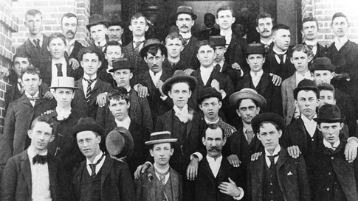
      North Carolina State University
“Land-Grant Legacy”
“NC State is in the midst of celebrating its March 7, 1887 founding. But another anniversary, 25 years earlier, is just as significant to the university’s history. On July 2, 1862, President Abraham Lincoln signed the Morrill Act, which led to the establishment of land-grant universities.”
      “

Slide 25
The Federal Government Started Requiring Matching Funds in 1887
  Hatch Act of 1887: Established Agriculture Experiment Stations
    Annual appropriation – State match required
  Smith-Lever Act of 1914: Established the Cooperative Extension Service
    Annual appropriation – State match required

Slide 26
  Second Morrill Act of 1890
    The Civil War ended on May 9, 1865 and was followed by a period of Reconstruction in the South.
    So by 1890 equal access to publically-funded facilities was an important issue in the country, especially in Congress!

Slide 27
  Second Morrill Act of 1890
    The Act provided two optional methods States could use to qualify for federal funds:
    Prove that race wasn’t a criteria for admission to their existing land-grant college or
    Establish a separate land-grant college for their black citizens!

Slide 28
  Second Morrill Act of 1890
    Every Southern state selected the second option and established a separate land-grant college for their black citizens, thus the “1890 Land-Grants” were created all over the then-segregated South!
      What NC School was established as a result of the Second Morrill Act?

Slide 29

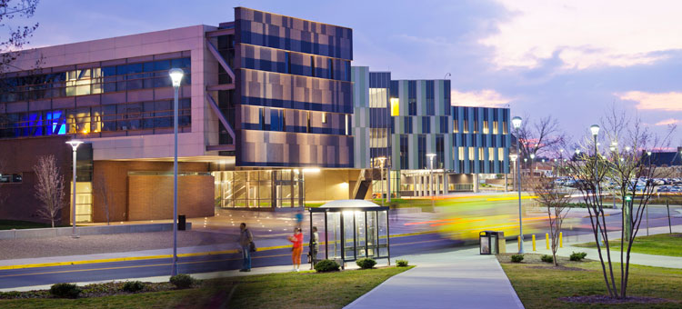
“1890 Land-Grant Legacy”
In 1890, Congress enacted the Second Morrill Act that mandated “a separate college for the colored race.” The Agricultural and Mechanical College for the Colored Race (now N.C. A&T) was established as that school in the state of North Carolina by an act of the General Assembly ratified on March 9, 1891.
      “

Slide 31
  Fast forward to WWI (July 28, 1914 to November 18,1918) - Congress established the Council of National Defense.
On August 29, 1916, Congress passed the Army Appropriation Act which authorized the creation of the CND. It consisted of the Secretaries of War, the Navy, the Interior, Agriculture, Commerce, and Labor. It was assisted by an Advisory Commission appointed by President Woodrow Wilson on October 11, 1916.
Function: To coordinate resources and industries for national defense.
Major Limitation: Little attempt to coordinate with academic research.
In January 1920, the Council recommended the creation of an Expert Survey Board to conduct research studies over the next six months to enable speedy mobilization in the event of another war. However…

Slide 32
  Fast forward to WWI (July 28, 1914 to November 18,1918) - Congress established the Council of National Defense.
On August 29, 1916, Congress passed the Army Appropriation Act which authorized the creation of the CND. It consisted of the Secretaries of War, the Navy, the Interior, Agriculture, Commerce, and Labor. It was assisted by an Advisory Commission appointed by President Woodrow Wilson on October 11, 1916.
Function: To coordinate resources and industries for national defense.
Major Limitation: Little attempt to coordinate with academic research.
… few changes were made in how university research was funded and there were no serious attempts to coordinate university research activities with industry/government research until WWII!

Slide 33
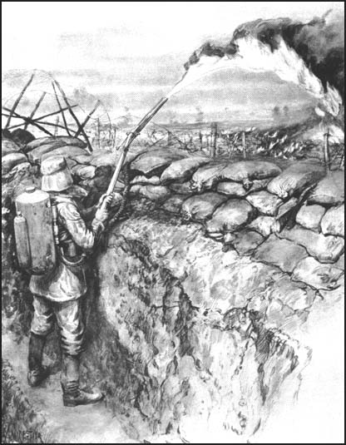
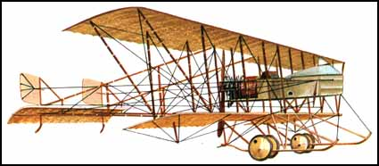
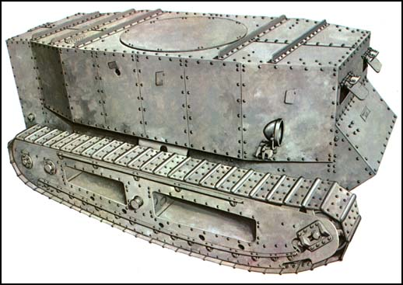
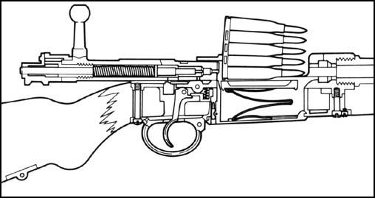
  Important Military Inventions from WWI (July 28, 1914 – November 18, 1918)
Flame Throwers
Aircraft (Farman)
Federal support for research is closely tied to military needs!
Armored Tanks
Bolt Action Rifles

Slide 34
  WWII - National Defense Research Council
    Learning from WWI failures to coordinate with university scientists, FDR established the NDRC in June of 1940 – a full 18 months before the December 7, 1941 attack on Pearl Harbor!
    To coordinate, supervise, and conduct scientific research on the problems underlying the development, production, and use of mechanisms and devices of warfare.
    Brought scientists from academia, industry and government together to address the needs of the U.S. military in a collaborative fashion.

Slide 35
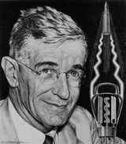
  The NDRC was later renamed the OSRD and headed by Dr. Vannevar Bush!
  Office of Scientific Research and Defense
    Inventor – Analog Computers
    Vice President and Dean of MIT School of Engineering
    Manhattan Project Administrator
    Raytheon Founder

Slide 36
Dr. Vannevar Bush
    Invented Memex, an adjustable microfilm viewer with a structure analogous to that of the WWW.
    “In 1945, Bush published As We May Think in which he predicted that "wholly new forms of encyclopedias will appear, ready made with a mesh of associative trails running through them, ready to be dropped into the memex and there amplified. The memex influenced generations of computer scientists, who drew inspiration from its vision of the future.”

Slide 37
  Innovative characteristics of the Office of Scientific Research and Defense (OSRD) which contributed to its success!
    Civilian, not military control
    Authority to contract work that was previously conducted in government labs to universities, private labs and industry
      Carnegie Institute of Technology – Large Rocket
      MIT – Radiation Lab
      Western Electric and Bell Labs – Sound Amplification

Slide 38
  Innovative characteristics of the Office of Scientific Research and Defense (OSRD) which contributed to its success!
    Civilian, not military control
    Authority to contract work previously conducted in government labs to universities, private labs and industry
    Highly centralized structure

Slide 39
  OSRD’s highly centralized structure was designed to emphasize:
  Vertical integration of methodology from fundamental science to production and
  Concentrated, massive rapid development and deployment!

Slide 40
  Example
  A device to jam Japanese torpedoes moved from a production prototype to full field deployment in just one week!
Imagine that speed in your lab?

Slide 41
  Innovative characteristics of the Office of Scientific Research and Defense (OSRD) which contributed to its success!
    Civilian, not military control
    Authority to contract work previously conducted in government labs to universities, private labs and industry
    Highly centralized structure
    Mission “to explore a possible government role in encouraging future scientific progress.”

Slide 42
Four Critical Technologies Pivotal to the Allied Victory!
  What were they?
  Atomic bomb (Manhattan project)
  Radar
      1935 – NRL – ship radar
      1942 – MIT – high-frequency, narrow-beam, high-resolution
      Manufactured by Sperry, Westinghouse, Philco (for aircraft)
      Cryptography
      ???

Slide 43

    Clue - What new “machines of war” were widely used by both sides in WWII?
    Airplanes!
    Military Challenge: To hit these highly maneuverable planes and knock them out of the sky!

Slide 44
      Approach prior to WWII was to
      use either a timed fuse
or a contact fuse.
- Neither approach was terribly effective against these highly maneuverable airplanes!

Slide 45
      Section T – Applied Physics Lab at Johns Hopkins University was assigned the task of developing a proximity or variable time fuse for use by the Navy’s 5” guns!

Slide 46
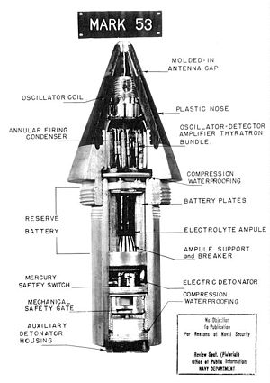
How Did the Proximity Fuse Work?
        Fuse contained a miniature radio transmitter- receiver which sent out a signal.
        When the signal which reflected back from a target reached a certain frequency (based on its proximity to the target), a circuit closed and fired a small charge which detonated the projectile.

Slide 47
Problems/Challenges
        Components – tiny glass vacuum tubes
        Force of 20,000 g’s when fired (2800 ft./sec. muzzle velocity)
        25,000 revolutions/minute through rifling grooves
        Moisture – fired from naval ships
        Self-destruct feature for dudes

Slide 48
Importance to War Effort
James V. Forrestal, Secretary of the Navy said, “The proximity fuse has helped me blaze the trail to Japan. Without the protection this ingenious device has given the surface ships of the fleet, our westward push could not have been so swift and the cost in men and ships would have been immeasurably greater.”
Prime Minister, Winston S. Churchill said, “These so-called proximity fuses, made in the United States, proved potent against the small unmanned aircraft with which we were assailed in 1944.”
Commanding General of the Third Army, George S. Patton said, “The funny fuse won the Battle of the Bulge for us. I think that when all armies get this shell we will have to devise some new method of warfare.”

Slide 49
Why Do I Tell This Story?
It was not certain the U.S. would win WWII - our survival as an independent country was in serious doubt.
The American public recognized and appreciated the important role science and technology had played in winning the war.

Slide 50
Why Do I Tell This Story?
The public’s confidence in the ability of science/technology to solve society’s problems was widespread.
Research, especially university-based research, was held in high regard!

Slide 51
The public was ready to invest tax dollars in university-based research at levels never before seen in the U.S.!
And boy, did they!
And they still do – President Obama’s 2012 budget request was ~ $150 billion for R&D.
For most U.S. universities, federal funding constitutes 75% or more of their research expenditures !

Slide 52
A Word of Caution
Public trust is fragile! What takes decades to earn can be lost in an instant if the public believes universities are no longer impartial and are not acting in the public interest!

Slide 53
    We are all responsible for maintaining this trust!
    Therefore, we must always conduct our research honestly, openly and consistent with the highest ethical standards!
This responsibility is the organizing principle for this course!

Slide 54
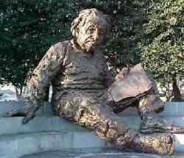
“The right to search for truth implies also a duty; one must not conceal any part of what one has recognized to be true.”
- Albert Einstein
“The only ethical principle which has made science
possible is that the truth shall be told all the
time…”
C.P. Snow “The Search” 1959

Slide 55
    The Endless Frontier: Vannevar Bush’s final report enumerated two principles for expanding R&D at U.S. universities.
    1. Federal government should be a patron of science.
    Government support should ensure a
    free rein of investigation by scientists into topics and methods of their choice!

Slide 56
    The Endless Frontier: Vannevar Bush’s final report enumerated two principles for expanding R&D at U.S. universities.
    1. Federal government should be a patron of science
      These principles still dominate federal grants – Contracts are a whole different matter!
    Government support should ensure a
    free rein of investigation by scientists
    into topics and methods of their choice!

Slide 57
Submitted in 1945, The Endless Frontier report ultimately lead to the establishment of the National Science Foundation (NSF) in 1950!

Slide 58
NIH’s History of Funding University Research
1798 – Marine Hospital Service was established to provide medical care for merchant seaman.
1891 – Hygienic Laboratory was established in Washington, DC with 1 employee working on “bacteriology.”
1901 – Congress appropriated $35K for construction of a new building for a Lab to investigate “infectious and contagious diseases and matters pertaining to the public health.”
1904 – The Lab was reorganized as the “Public Health and Marine Hospital Service” with 3 Divisions - Chemistry, Pharmacology and Zoology.

Slide 59
Brief History of NIH
WWI – The primary mission for the PHS was to deal with sanitation of areas around military bases.
1930 – Ransdell Act changed the name of the Hygienic Laboratory to the National Institute (singular) of Health and authorized establishment of fellowships for research into “basic biological and medical problems” – Amazing that this was done in the middle of the Great Depression!
1937 – Congress created the National Cancer Institute with every Senator voting in favor. This action revealed the public’s growing concern with cancer and began the “categorical-disease structure” of NIH. NCI was authorized to award grants to nonfederal employee scientists!

Slide 60
Beginning of “Extramural Research”
WWII – focus was on war-related problems:
research on hazardous substances and ways to protect workers in war industries;
development of vaccines and therapies to address tropical diseases (yellow fever and typhus);
discovery that sodium deficiency was a leading cause of death after burns which lead to the widespread use of saline therapy on the battlefield;
discovery of the optimal altitude for administering oxygen to pilots to prevent “blackouts”; and much more!
Some of this research was conducted by universities funded by NIH grants!

Slide 61
“Extramural Research” (Grants) Expanded Throughout NIH
1944 – NCI was specifically designated as a component of NIH. Note: Only two NIH officers are direct Presidential appointments: the Directors of NIH and NCI.
1946 – Public Health Act expanded the successful grants program at NCI to all of NIH.
1946 to 1949 – New Institutes were created for mental health, dental disease and heart disease. By 1960 there were 10 Institutes, by 1970 there were 15 and by 2000 there were 27 Institutes and Centers.

Slide 62
Major DOD Funding Agencies
DARPA – Established in 1958 in response to the launching by the Soviet Union of Sputnik, the Defense Advanced Research Projects Administration is the main research and development office for the U.S. Department of Defense. It’s mission is to “maintain technological superiority of the U.S. military and prevent technological surprise from harming our national security.”
ARO – The Army Research Office was established as the Army’s “premier extramural basic research agency in the engineering, physical, information and life sciences; developing and exploiting innovative advances to ensure the Nation’s technological superiority.”

Slide 63
Major DOD Funding Agencies
ONR – The Navy established it’s first Naval Research Lab (NRL) in 1923. In 1946, President Truman signed legislation establishing the Office of Naval Research (ONR) to “plan, foster and encourage scientific research in recognition of its paramount importance as related to the maintenance of future naval power and the preservation of national security.”
AFOSR – The Air Force Office of Scientific Research, beginning in 1948 as the Office of Air Research at Wright Field in Ohio, grew dramatically after the launch of the Sputnik by the Soviet Union. It’s mission was to “support Air Force goals of control and maximum utilization of air, space and cyberspace.”

Slide 64
Observations concerning DOD Funding of University Research
Preference for contracts over grants.
Importance of “deliverables” in contracts.
A nice arrangement - Universities as subcontractors to large defense contractors with the university doing more of the basic science and with the company being responsible for the integration of basic science with applied research and producing contract deliverables.
Note: Many DOD-funded projects often have significant civilian applications!

Slide 65
Impact of Federal Funding on Universities
Since WWII, the federal government has become the primary source for funding university research – often 75-90% of an institution’s entire research portfolio.
Many universities (including UNC-CH) receive more money from competitively awarded research contracts/grants than from any other source - including state government appropriations.

Slide 66
Sponsored Awards v. State Appropriations at UNC-CH

Slide 67
UNC-Chapel Hill Funding
    The annual allocation to UNC-Chapel Hill from NC state government is ~ $448 million.
    Funding has been reduced during the recession, but NC and Wisconsin are the only states currently providing this level of funding to their flagship public university – the norm is < $200m.
    Even as state support has continued to represent a smaller % of the budget, the state has maintained 100% control, e.g., state personnel policies, state purchasing requirements, state construction rules.

Slide 68
Special Impact on Public Universities
    Many states have granted more flexibility and autonomy to their public universities – some are now called “state affiliated.”
    Setting tuition rates, modifying in-state and out-of state admission limits, modifying personnel policies, providing greater budget flexibility – these are just a few examples of the changes at many public universities as state financial support has been reduced.

Slide 69
Special Impact on Public Universities
    The competition for scarce state dollars has, in some situations, created tension between the research-intensive “flagship universities” and the smaller more teaching-oriented campuses within statewide university systems.
    The mistaken perception that large portions of flagship university budgets can be “off-loaded” to federal research grants adds to this tension!

Slide 70
Important Implications for
Institutional Governance
Faculty are funding an ever greater portion of “university research” through competitively awarded grants/contracts.
    Frequently they provide most (sometimes all) of their own salary from these awards.
    What are the implications for the traditional employer-employee relationship?

Slide 71
Important Implications for
Institutional Governance
    Are faculty pursuing knowledge or just “chasing available money?”
    How does an institution maintain balance between teaching, research and public service when funding for each varies so widely?
    As faculty work more closely with industry and rely upon industry money to support their research, how do universities protect academic integrity and scientific impartiality?
    Conflict of Interest Issues!

Slide 72
Last Thoughts for Today!
The current federal budget crisis (and the overall mood of the country concerning the budget deficit) may jeopardize future funding of university-based research!
The loss of future industries and the jobs these industries would create may be the unintended consequence of these cuts.
This disturbing trend is not new - from 1970 to 1995 federal support for research in the physical sciences as a fraction of GDP declined by 54% and in engineering by 51%.

Slide 73
Last Thoughts for Today!
Reducing research funding to balance the budget is sort of like making an overweight aircraft flight-worthy by removing an engine!
Or, to use an agricultural example:
It’s like eating your seed corn!

